Slide 1
Solution Template

Slide 2
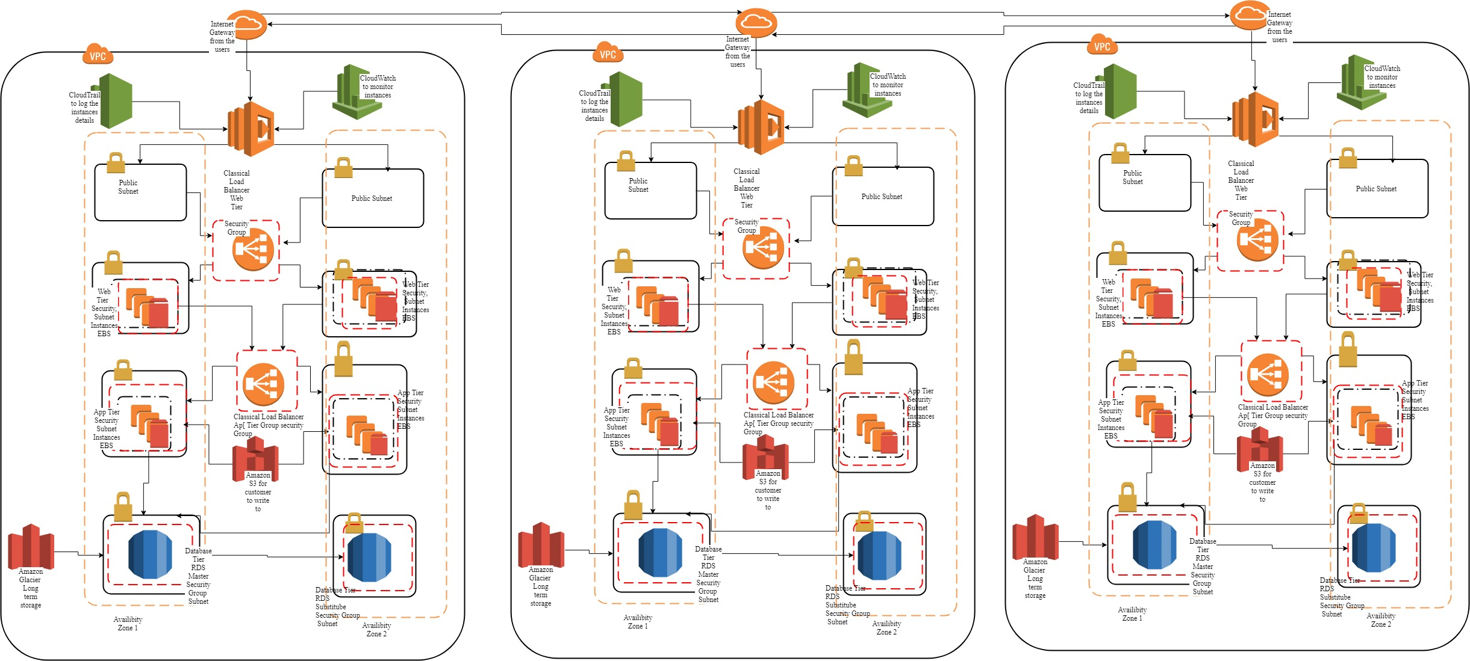
Which Services Will You Use?

Slide 3
Users, Groups, and Roles
InnoMed Account
Group:
System Admin
Group:
Database Admin
Group:
Monitor
Role:
Application
Web Admin
ShortTerm Storage Admin
Web Tier
Customer
App Admin
Application tiers
LongTerm Storage Admin
Database tiers
Use the chart to document users, groups, and roles created.
Trafficing between all tiers

Slide 4
Users, Groups, and Roles
Group/Role # | Group/Role Name | Permissions
Group | System Admin | Full Access to Amazon VPC, EC2, Access IAM Read and write Amazon S3, EBS, EFS, Glacier Read from Amazon CloudWatch
Group | Database Admin | Full access to Amazon RDS Read Only to Amazon S3, EBS, EFS, Glacier Read from Amazon CloudWatch

Slide 5
Users, Groups, and Roles
Group/Role # | Group/Role Name | Permissions
Group | Monitor | Full Access to Amazon CloudWatch Read only from Amazon EC2, S3, RDS
Role | Application | Read and write to Amazon S3

Slide 6
Password Policy
Requirement | Solution
Should be at least 8 characters and have 1 uppercase, 1 lowercase, 1 special character, and a number. | Create a password policy that set the requirements of the following: min characters of 8, contain at least one uppercase character from the ISO basic Latin alphabet (A to Z), contain at least one lowercase character from the ISO basic Latin alphabet (A to Z), contain at least nonalphanumeric characters and Contain at least one number
Change passwords every 90 days and ensure that the previous three passwords can’t be re-used. | Enable password expiration with also the enable of prevent password reuse. Use Cloudwatch to track this usage and notify the user when they have to update their password

Slide 7
Password Policy
Requirement | Solution
Administrator sign-in to the AWS Management Console requires the use of Virtual MFA. | For the group System Admin and database admin, I would enable Virtual MFA by going into Manage MFA device and show secret key. Then assign that MFA to the group.
All administrators require programmatic access | Enable Pair key access from terminal from those who are in the administrator. Then confidential send the private key pair to the user to access to the certain systems that they want.

Slide 8
VPC Details
VPC | Region | Purpose | Subnets | AZs | CIDR range
1 | EU - eu-west-3 | Production | 8 | 2 | /24
2 | APAC ap-southeast-1 | Test | 8 | 2 | /24
3 | USA us-west-1 | Development | 8 | 2 | /24

Slide 9
Production Subnet Details
Subnet Name | VPC | Subnet type (Public/private) | AZ | Subnet Address
Public Subnet 1 | #1 | Public | eu-west-3a | 10.0.0.1
Public Subnet 2 | #1 | Public | eu-west-3b | 10.0.0.2
Private WebPro 1 | #1 | Private | eu-west-3a | 10.0.0.3
Private WebPro 2 | #1 | Private | eu-west-3b | 10.0.0.4
Private AppPro 1 | #1 | Private | eu-west-3a | 10.0.0.5
Private AppPro 2 | #1 | Private | eu-west-3b | 10.0.0.6
Private DBPro 1 | #1 | Private | eu-west-3a | 10.0.0.7
Private DBPro 2 | #1 | Private | eu-west-3b | 10.0.0.8

Slide 10
Test Subnet Details
Subnet Name | VPC | Subnet type (Public/private) | AZ | Subnet Address
Public Subnet 3 | #2 | Public | ap-southeast-1a | 10.0.0.9
Public Subnet 4 | #2 | Public | ap-southeast-1b | 10.0.0.10
Private WebTest 1 | #2 | Private | ap-southeast-1a | 10.0.0.11
Private WebTest 2 | #2 | Private | ap-southeast-1b | 10.0.0.12
Private AppTest 1 | #2 | Private | ap-southeast-1a | 10.0.0.13
Private AppTest 2 | #2 | Private | ap-southeast-1b | 10.0.0.14
Private DBTest 1 | #2 | Private | ap-southeast-1a | 10.0.0.15
Private DBTest 2 | #2 | Private | ap-southeast-1b | 10.0.0.16

Slide 11
Dev Subnet Details
Subnet Name | VPC | Subnet type (Public/private) | AZ | Subnet Address
Public Subnet 5 | #3 | Public | us-west-1a | 10.0.0.17
Public subnet 6 | #3 | Public | us-west-1 b | 10.0.0.18
Private WebDev 1 | #3 | Private | us-west-1 a | 10.0.0.19
Private WebDev 2 | #3 | Private | us-west-1 b | 10.0.0.20
Private AppDev 1 | #3 | Private | us-west-1 a | 10.0.0.21
Private AppDev 2 | #3 | Private | us-west-1 b | 10.0.0.22
Private DBDev 1 | #3 | Private | us-west-1 a | 10.0.0.23
Private DBDev 2 | #3 | Private | us-west-1 b | 10.0.0.24

Slide 12
Instance Details
Describe the type, size, and justification for the instances you will use for each tier.
Tier | Tag* | OS | Type | Size | Justification | # of instances | User Data?
Web | Key = Name Value = web-tier | Windows Server 2016 Base 10 | EC2 | T3. meduim | Meeting the min requirements for the servers to run with the original architecture and allows for double the current server numbers | 4 | Input / Output
App | Key = Name Value = app-tier | Windows Server 2016 Base 10 | EC2 | T3.large | To stick with the original architecture as well as spreading the information around the servers without having the cost too high as well as allows for double the current server numbers | 16 | Processed
* Tags must be configured as shown to meet the lab objectives

Slide 13
Instance Details
Describe the type, size, and justification for the instances you will use for each tier.
Tier | Tag* | OS | Type | Size | Justification | # of instances | User Data?
DB | Key = Name Value = db-tier | Window Server 2016 Base 10 | RDS | T2.2xlarge | Same as application tier | 2 | Stored
* Tags must be configured as shown to meet the lab objectives

Slide 14
Load Balancer Security Group Details
Load Balancer | Name* | External/Internal | Subnets | SG Name* | Rule | Source
For Web Tier | Web Classic LB | Both | Web Instances Subnets | Web Load Balancer Security Group | Accept Requests only from port 80 for HTTP requests, 433 for HTTPS requests and 22 for TCP requests | Internet
For App Tier | App Classic LB | Both | Application Instances Subnets | App Load Balancer Security Group | Accept Requests from port 8080 only | Web Tier Servers
* Names must be configured as shown to meet the lab objectives

Slide 15
Instance Security Group Details
Instance Tier | SG Name* | Rule | Source
Web Tier | Web Instance Tier Security Group | Accept Requests from port 80 only | Web Tier Load balancer
App Tier | App Instance Tier Security Group | Accept Requests from port 80 only | Application Tier load balancer
Database Tier | Database Instance Tier Security Group | Accept Requests from port 80 for HTTP only | Application Tier server
* Names must be configured as shown to meet the lab objectives

Slide 16
Auto Scaling Launch Configuration
Tier | OS | Type | Size | Configuration Name* | Role | Security Group
Web | Windows Server 2016 Base 10 | EFS | T2.meduim | Web Tier Auto Scale |  | Web Instance Tier Security Group
App | Windows Server 2016 Base 10 | EFS | T2.large | App Tier Auto Scale |  | App Instance Tier Security Group
* Name must be configured as shown to meet the lab objectives

Slide 17
Auto Scaling Group
Tier | Launch Configuration* | Group Name* | Group Size | VPC | Subnets | ELB | Tags
Web | Web Tier Auto Scale | System Admin | 2 | 1,2,3 | 10.0.0.1, 10.0.0.9, 10.0.0.17 | Web Classic LB | Key = Name Value = web-tier
App | App Tier Auto Scale | System Admin | 2 | 1,2,3 | 10.0.0.1, 10.0.0.9, 10.0.0.17 | App Classic LB | Key = Name Value = app-tier
* Names must be configured as shown to meet the lab objectives

Slide 18
Auditing Options
Q. How do you configure an account to create an audit trail for all executed API calls?
By enabling CloudTrail inside the account to track the API calls, and logs, and given it permissions to do the nesscary tasks (read, write, all or not)
Q. Where do you save your logs?
I would save it to the CloudWatch logs which when an
API activity happens, send a sms.
Notes:
Enable CloudTrail for all regions, and save all API call logs in an S3 bucket.

